Slide 1
Object-oriented Programming
Week 9 | Lecture 1&2

Slide 2
default arguments in c++
A default argument is a value provided in a function declaration that is automatically assigned by the compiler if the caller of the function doesn’t provide a value for the argument with a default value.

Slide 3
Rule 1
Default arguments must be the rightmost (trailing) arguments in a function’s parameter list. default arguments are assigned from right to left
Once we provide a default value for a parameter, all subsequent parameters must also have default values. For example,

Slide 4
// Invalid
void add(int a, int b = 3, int c, int d);
// Invalid
void add(int a, int b = 3, int c, int d = 4);
// Valid
void add(int a, int c, int b = 3, int d = 4);

Slide 5
Rule 2
If we are defining the default arguments in the function definition instead of the function prototype, then the function must be defined before the function call.

Slide 6
// Invalid code
int main() {
// function call
display();
}
void display(char c = '*', int count = 5) {
// code
}

Slide 7
Operator Overloading
C++ allows you to specify more than one definition for an operator in the same scope, which is called operator overloading.
You can redefine or overload most of the built-in operators available in C++
It is a type of polymorphism in which an operator is overloaded to give user defined meaning to it.

Slide 8
Operator Overloading
Defining a new behavior for common operators of a language
C++ enables you to overload most operators to be sensitive to the context in which they’re used
Using operator overloading makes a program clearer than accomplishing the same operations with function calls

Slide 9
When operators are overloaded as member functions, they must be non-static
When operators are overloaded as member functions, they must be non-static because they operate on instances of a class
Static Functions Do Not Have this
A static function does not have access to this, meaning it cannot directly access instance variables.
Since operator overloading usually involves modifying or accessing object attributes, a static function would not work properly.

Slide 10
Operator Overloading
An operator is overloaded by writing a non-static member function definition or global function definition
To use an operator on class objects (as operands), that operator “must” be overloaded

Slide 11
Operator Overloading
Operator overloading cannot change the arity of an operator
Operator overloading works when at least one argument of that operator is an object
We cannot create new operators using operator overloading

Slide 12
LIST OF OPERATORS THAT CAN’T BE OVERLOADED
Almost any operator can be overloaded in C++. However there are few operator which can not be overloaded.
scope operator (::)
sizeof
member selector –(.)
member pointer selector – (.*)
ternary operator – (?:)

Slide 13
BUILT IN OVERLOADS
Most operators are already overloaded for fundamental types.
Example:
1) In the case of the expression:
a / b the operand type determines the machine code created by the compiler for the division operator. If both operands are integral types, an integral division is performed;
in all other cases floating-point division occurs. Thus, different actions are performed depending on the operand types involved.
2) <<, which is used both as the stream insertion operator and as the bitwise left-shift operator.

Slide 14
Works fine
#include <iostream>
using namespace std;
int main() {
int a=5;
int b=3;
int z=a+b;
cout << z;
return 0;}

Slide 15
Output?
#include <iostream>
using namespace std;
class Complex {
private:
int real;
int image;
public:
Complex(){
real = 0;
image = 0; }
Complex(int r, int i){
real = r;
image = i;}

Slide 16
Output?
void displayComplex() {
cout << "real: "<< real << " Imaginary:" <<image <<endl; }};
int main() {
Complex c1(2,1);
Complex c2(3,1);
Complex c3;
c3=c1+c2;
return 0;}

Slide 17
Output
[Error] no match for 'operator+' (operand types are 'Complex' and 'Complex')

Slide 18
criteria/rules to define the operator function:
In case of a non-static function, the binary operator should have only one argument and unary should not have an argument.

Slide 19
Syntax of Operator Overloading
Return type operator op(argument list);
return_type class_name : : operator op(argument_list)
{
// function body
}

Slide 20
Example of Operator Overloading
class Complex {
private:
int real;
int image;
public:
Complex(){
real = 0;
image = 0; }
Complex(int r, int i){
real = r;
image = i;}

Slide 21
Example of Operator Overloading
void displayComplex() {
cout << "real: "<< real << " Imaginary:" <<image <<endl; }
// overloaded (+) operator
Complex operator+ (Complex c) {
Complex temp;
temp.real=real+c.real;
temp.image=image+c.image;
return temp;
}};

Slide 22
Example of Operator Overloading
int main() {
Complex c1(2,1);
Complex c2(3,1);
Complex c3;
c3 = c1.operator+ ( c2 );
//c3=c1+c2;
c3.displayComplex();
return 0;}

Slide 23
c3=c1+c2; // statement 1
It is same like
c3=c1.add(c2); just for understanding
In statement 1, Left object c1 will invoke operator+() function and right object c2 is passing as an argument.
Another way of calling binary operator overloading function is to call like a normal member function as follows,
c3 = c1.operator+ ( c2 );

Slide 24
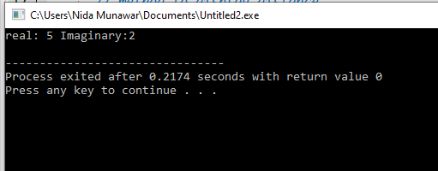

Slide 25
int main() {
Complex c1(2,1);
Complex c2(3,1);
Complex c3(1,1);
Complex c4;
c4=c1+c2+c3;
c4.displayComplex();
return 0;}

Slide 26
c4=c1+c2+c3;
Firstly addition of c1+c2 happen then the result of c1+c2 added to c3 and stored in c4 here add function called two times

Slide 27
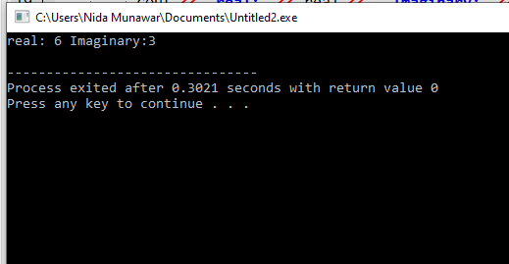

Slide 28
#include <iostream>
using namespace std;
class Binary {
int i;
public:
Binary(int val = 0) : i(val) {}
// Binary + Operator Overload (returns new object)
Binary operator+(const Binary& obj) {
Binary temp; // Create a new object (temp)
temp.i = this->i + obj.i;
return temp; // Return new object (not reference)
}
void Display() const {
cout << "i=" << i << endl;
}
};

Slide 29
int main() {
Binary obj1(5), obj2(3), obj3;
obj3 = obj1 + obj2; // obj3 = obj1.operator+(obj2);
obj3.Display(); // Output: i=8
Binary obj4;
obj4 = obj1 + obj2 + obj3; // Chaining works: obj4 = (obj1 + obj2) + obj3;
//obj4 = obj1.operator+(obj2).operator+(obj3);
obj4.Display(); // Output: i=16
return 0;
}

Slide 30
Step-by-Step Execution of obj1 + obj2 + obj3
First, obj1 + obj2
temp1.i = obj1.i + obj2.i = 5 + 3 = 8
Returns a new object (temp1 with i=8).
Then, temp1 + obj3
temp2.i = temp1.i + obj3.i = 8 + 8 = 16
Returns another new object (temp2 with i=16).
Assign result to obj4
obj4 = temp2
obj4.i = 16

Slide 31
Step-by-Step Breakdown:
obj1 + obj2 → Calls obj1.operator+(obj2), returns a new
object (say temp1).
temp1 + obj3 → Calls temp1.operator+(obj3), returns
another new object (say temp2).
obj4 = temp2 → Assigns temp2 to obj4.

Slide 32
Prefix Increment (++i)
Increments first, then returns the updated value.
#include <iostream>
int main() {
int i = 5;
int x = ++i;
std::cout << "i = " << i << std::endl;
std::cout << "x = " << x << std::endl;}

Slide 33
Postfix Increment (i++)
Returns the original value first, then increments.
#include <iostream>
int main() {
int i = 5;
int x = i++;
std::cout << "i = " << i << std::endl;
std::cout << "x = " << x << std::endl;
}

Slide 34
Difference between post and prefix
int y=0;
y=x++;
cout <<x;
cout<<y;

Slide 35
X=1
Y=0
In postfix firstly substitute the value then increment happens

Slide 36
For Prefix ++ operator
void operator ++ ( )
{
++x;
++y;
}
(Works the same way for prefix decrement operator)

Slide 37
For Prefix ++ operator
class Prefix{
int i;
public:
Prefix(): i(0) { }
void operator ++()
{ ++i; }
void Display()
{ cout << "i=" << i << endl; }};
int main(){
Prefix obj;
obj.Display();
++obj;
//you can also write obj.operator ++();
obj.Display();
return 0;}

Slide 38
Prefix (++obj) works by first incrementing and then returning the object.
Returning *this allows chaining (++(++obj);).
class Prefix {
int i;
public:
Prefix() : i(0) {}
// Prefix increment overloading
Prefix& operator++() { // Returning reference
++i;
return *this; // Return the updated object
}
void Display() {
cout << "i=" << i << endl;
}
};

Slide 39
int main() {
Prefix obj;
obj.Display(); // i = 0
++obj; // Calls operator++()
obj.Display(); // i = 1
++(++obj); // Works because we return a reference
// obj.operator++().operator++();
obj.Display(); // i = 3
return 0;
}

Slide 40
execution order
This means that the execution order follows left-to-right evaluation:
obj.operator++() → modifies obj (increases value by 1)
obj.operator++() (on the modified obj) → modifies obj again
(increases value by 1 more)

Slide 41
Output?
#include <iostream>
class Number {
int value;
public:
Number(int v) : value(v) {}
Number(){ }
Number operator++() {
Number z;
z= ++value;
return z; }
void display() const {
std::cout << "Current Value: " << value << std::endl;
}};

Slide 42
int main() {
Number obj(5);
obj.display();
Number o;
o=++(++obj); //obj.operator++().operator++();
obj.display();
o .display();//effects on z object
return 0;
}

Slide 43
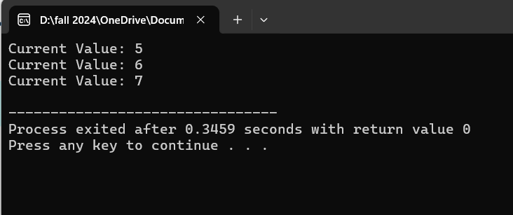

Slide 44
distinguish between post and prefix
The operator symbol for both prefix(++i) and postfix(i++) are the same. Hence, we need two different function definitions to distinguish between them. This is achieved by passing a dummy int parameter in the postfix version.

Slide 45
For Postfix ++ Operator
#include<iostream>
using namespace std;
class Postfix{
int i;
public:
Postfix(): i(0) { }
void operator ++(int)
{ i++; }
void Display()
{ cout << "i=" << i << endl; }};

Slide 46
int main(){
Postfix obj;
obj.Display();
obj.operator ++(4);//for this syntax you must have to pass a dummy value
// you can also write obj++;
obj.Display();
return 0;}

Slide 47
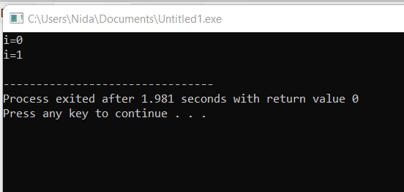

Slide 48
It should return old value as postfix rules
#include <iostream>
using namespace std;
class Postfix {
int i;
public:
Postfix() : i(0) { }
Postfix operator++(int) {
Postfix temp = *this; // Store current state
i++; // Increment current object
return temp; // Return old state
}
void Display() {
cout << "i = " << i << endl;
}
};

Slide 49
Correct code for postfix
int main() {
Postfix obj;
obj.Display();
Postfix obj2 = obj++;
obj.Display();
obj2.Display(); // Should still hold old value
return 0;
}

Slide 50
Prefix (++obj) allows chaining because it returns
*this (a reference).
Postfix (obj++) cannot allow chaining because it must
return a temporary copy.
Since temp is a local object, it gets destroyed after the function returns. So, if we write:
obj++.operator++();
This will not compile, because obj++ returns a temporary object, and we cannot modify a temporary.

Slide 51
Output?
class Check{
int i;
public:
Check(): i(0) { }
Check operator ++ (int){
Check temp;
temp.i = i++;
return temp;}
void Display()
{ cout << "i = "<< i <<endl; }};

Slide 52
Output?
int main(){
Check obj, obj1;
obj.Display();
obj1.Display();
obj1 = obj++;
obj.Display();
obj1.Display();
return 0;}

Slide 53
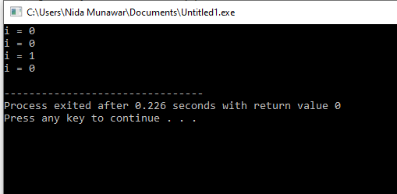
Output

Slide 54
Why Not return *this; in Postfix?
#include <iostream>
using namespace std;
class Postfix {
int i;
public:
Postfix() : i(0) { }
Postfix& operator++(int) {
i++; // Increment first
return *this; }
void Display() {
cout << "i = " << i << endl;
}
};

Slide 55
int main() {
Postfix obj;
obj.Display();
Postfix obj2 = obj++;
obj.Display();
obj2.Display();
return 0;
}

Slide 56
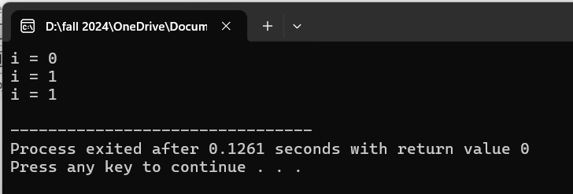

Slide 57
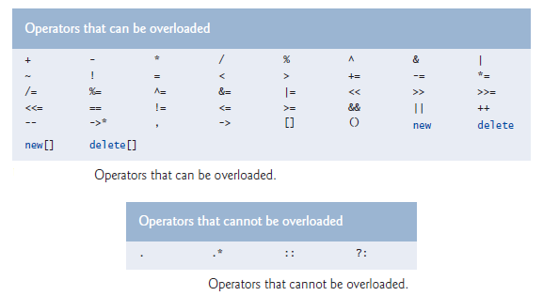
Restrictions on Operator Overloading

Slide 58
Assignment Operator =
The assignment operator has a signature like this:
class MyClass {
public:
MyClass & operator=(const MyClass &rhs);
} ;
int main(){
MyClass a, b; ...
b = a; // Same as b.operator=(a);
}

Slide 59
Notice that the = operator takes a const-reference to the right hand side of the assignment.
The reason for this should be obvious, since we don't want to change that value; we only want to change what's on the left hand side.
Also, you will notice that a reference is returned by the assignment operator.
This is to allow operator chaining. You typically see it with primitive types, like this:

Slide 60
operator chaining
operator chaining with primitive types, like this:
int a, b, c, d, e;
a = b = c = d = e = 42;
This is interpreted by the compiler as:
a = (b = (c = (d = (e = 42))));
In other words, assignment is right-associative. The last assignment operation is evaluated first, and is propagated leftward through the series of assignments. Specifically:
e = 42 assigns 42 to e, then returns e as the result
The value of e is then assigned to d, and then d is returned as the result
The value of d is then assigned to c, and then c is returned as the result etc.

Slide 61
operator chaining
Now, in order to support operator chaining, the assignment operator must return some value. The value that should be returned is a reference to the left-hand side of the assignment.

Slide 62
operator chaining with =
#include <iostream>
using namespace std;
class MyClass {
private:
int value; // Example member variable
public:
// Constructor
MyClass(int val = 0) : value(val) {}
MyClass& operator=(const MyClass &rhs) {
this->value = rhs.value; }
return *this; // Return reference to the current object
}
void display() const {
cout << "Value: " << value << endl;
}
};

Slide 63
int main() {
MyClass a(10), b(20) , c(30);
cout << "Before assignment:" << endl;
a.display();
b.display();
c.display();
c = b = a;
cout << "After assignment:" << endl;
a.display();
b.display();
c.display();
return 0;
}

Slide 64
Explanation:
c = b = a; // Same as b.operator=(a), then c.operator=(b);
Right-to-left evaluation:
b = a → Calls b.operator=(a), copying a into b.
c = b → Calls c.operator=(b), copying b (which is now equal to a) into c.
Since operator= returns *this (a reference to the current object),
it allows chaining (c = b = a works as (c = (b = a))).

Slide 65
operator chaining
#include<iostream>
using namespace std;
int main(){
int a = 10 , b , c = 0;
(b=c)=a;
cout << "b is :" << b << endl;
cout << "c is :" << c << endl;
}

Slide 66
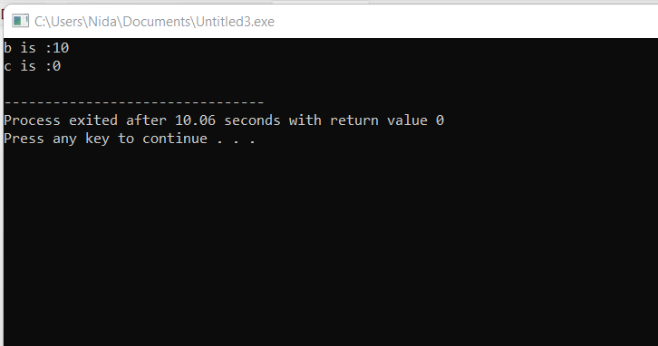
operator chaining

Slide 67
operator chaining
#include<iostream>
using namespace std;
class chain {
private:
int var;
public:
chain(){
var = 0; }
chain(int val){
var = val;
}
void display() {
cout << "var: "<< var <<endl; }

Slide 68
operator chaining
// overloaded (=) operator
chain& operator= (chain rhs) {
this->var=rhs.var; // this pointer is optional here
return *this; }};

Slide 69
operator chaining
int main() {
chain c1(2);
chain c2 , c3;
(c2=c3)=c1;
c2.display();
c1.display();
c3.display();
return 0;}

Slide 70
Step 1: c2 = c3 → c2.operator=(c3)
Copies c3.var into c2.var.
Returns *this (which is c2).
Step 2: (c2 = c3) = c1 → Now, c2 = c1
Copies c1.var into c2.var.

Slide 71
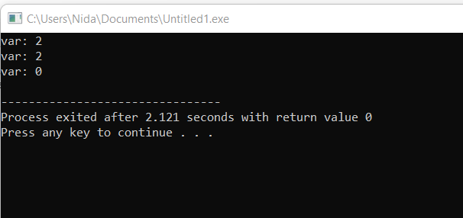
operator chaining

Slide 72
operator chaining
If you are returning by value

Slide 73
Works fine when there is no parenthesis
// overloaded (=) operator
chain operator= (chain rhs) {
this->var=rhs.var; // this pointer is optional here
return *this; }};
int main() {
chain c1(2);
chain c2 , c3;
c2=c3=c1;
c2.display();
c1.display();
c3.display();
return 0;}

Slide 74
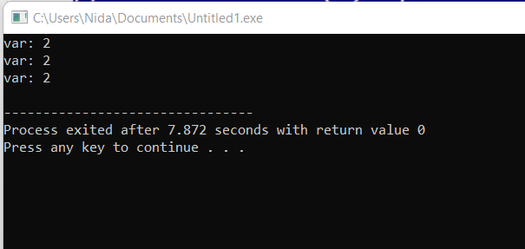
operator chaining

Slide 75
If you are returning by value
chain operator= (chain rhs) {
this->var=rhs.var;
return *this; }
int main() {
chain c1(2);
chain c2 , c3;
(c2=c3)=c1;
c2.display();
c1.display();
c3.display();
return 0;}

Slide 76
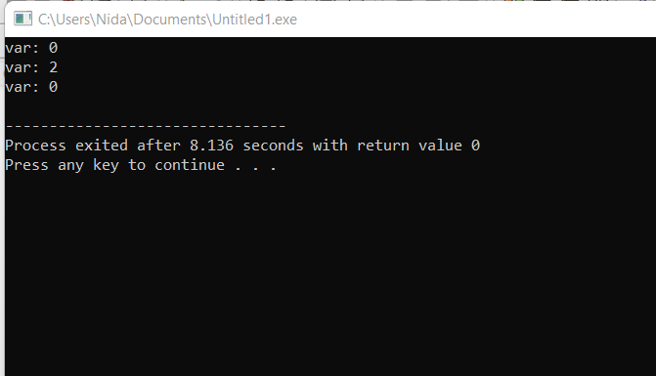
operator chaining
Operator chaining is not possible by returning value you must return reference

Slide 77
Issue: Returning by Value (chain operator=(chain rhs))
Your assignment operator is returning a copy instead of
a reference. (c2 = c3) = c1;
c2 = c3 returns a temporary object (copy) of c2.
Then, = c1 is applied to this temporary copy, not c2 itself.
This means c2 is not affected by c1, and its value remains
from c3.

Slide 78
In Pass by value changes only reflect inside function scope not in main
#include<iostream>
using namespace std;
class chain {
private:
int var;
public:
chain(){
var = 0; }
chain(int val){
var = val;
}
void display() {
cout << "var: "<< var <<endl; }
chain operator= (chain rhs) {
this->var=rhs.var;
cout << "inside func" << rhs.var<< endl;
return *this; }
};
int main() {
chain c1(2);
chain c2 , c3;
(c2=c3)=c1;
c2.display();
c1.display();
c3.display();
}

Slide 79
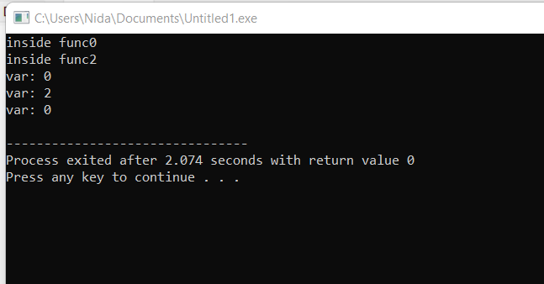

Slide 80
operator chaining
So, for the hypothetical MyClass assignment operator, you would do something like this:
// Take a const-reference to the right-hand side of the assignment.
// Return a non-const reference to the left-hand side.
MyClass& MyClass::operator=(const MyClass &rhs) {
... // Do the assignment operation!
return *this; // Return a reference to myself.
}

Slide 81
operator chaining
Remember, this is a pointer to the object that the member function is being called on. Since a = b is treated as a.operator=(b), you can see why it makes sense to return the object that the function is called on; object a is the left-hand side.
But, the member function needs to return a reference to the object, not a pointer to the object. So, it returns *this, which returns what this points at (i.e. the object), not the pointer itself. (In C++, instances are turned into references, and vice versa, pretty much automatically, so even though *this is an instance, C++ implicitly converts it into a reference to the instance.)

Slide 82
For += operator
Vector& operator += (const Vector &ob)
{ x += ob.x;
y += ob.y;
return *this;
}

Slide 83
For Unary - operator (Negation)
Vector operator – ( ) const
{ Vector temp;
temp.x = -x;
temp.y = -y;
return temp;
}

Slide 84
Next Lecture
Function Overriding

